Slide 1

Finncare Website redesign
Made by: Lasse 4
Members: Aleksi Oikarinen, Matias Malmberg, Subash Chhetri, Tuomas Hartikainen, Sachet Dahal, Sadia Rumpa, Sadia Sanji & Valtteri Koivisto.

Slide 2
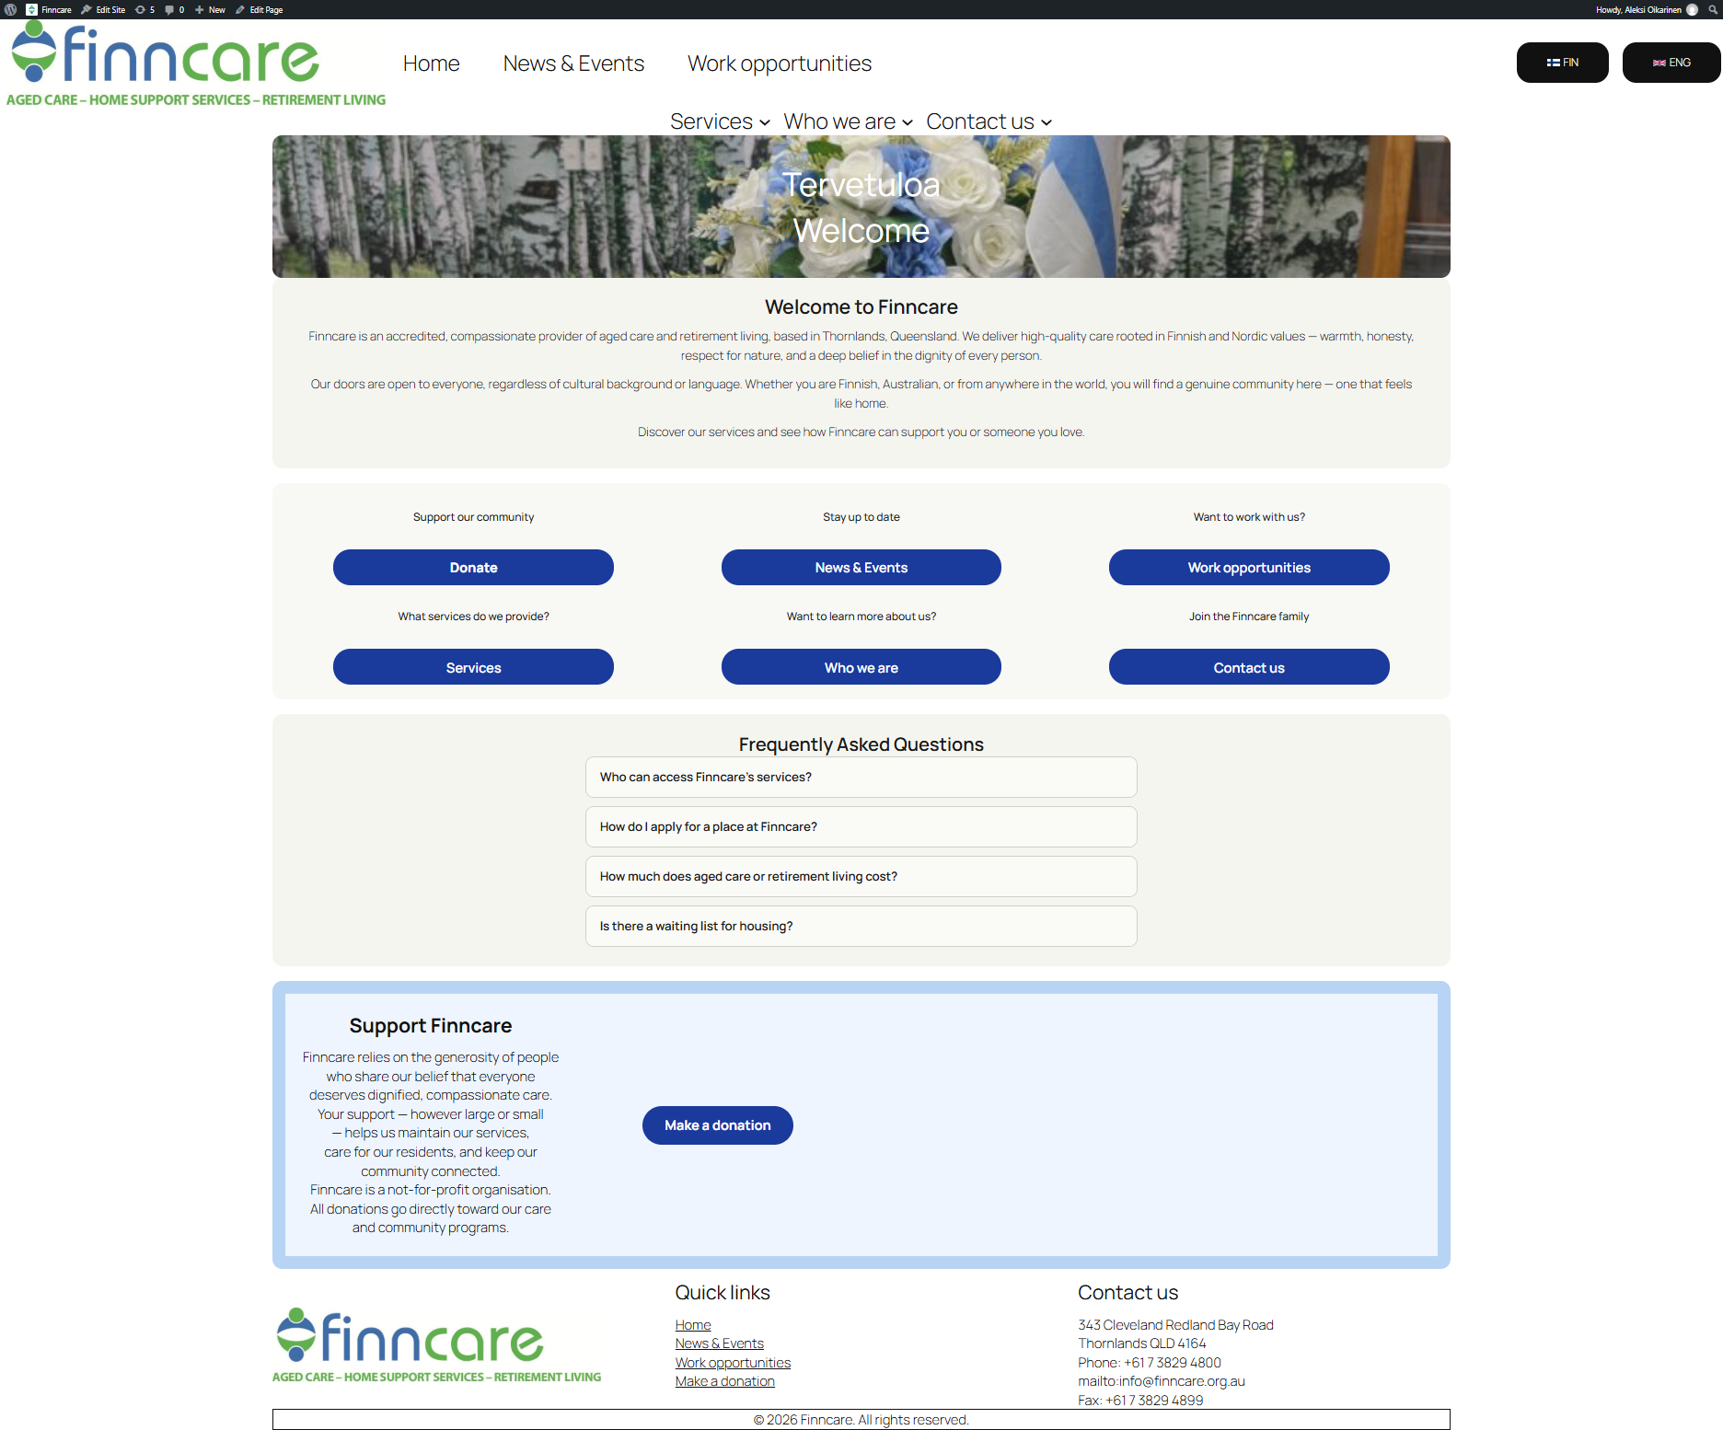
Home page
Focused on clarity
Less text
Welcoming to the eye
Larger buttons
FAQ section

Slide 3
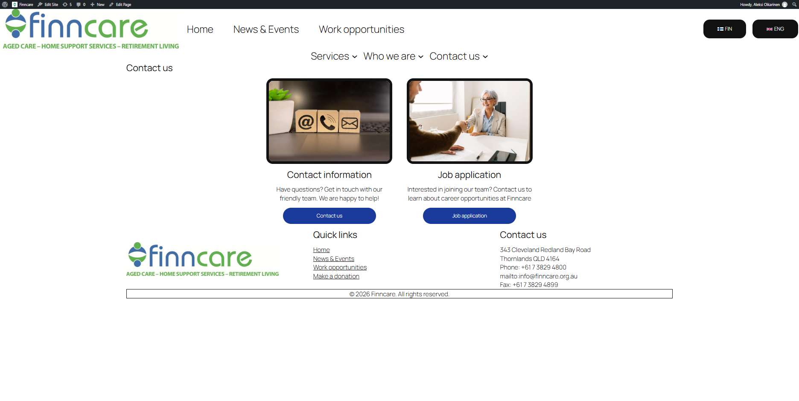
Contact us page
Made a quick access page for contact us so that the top bar isn’t the only way to access its contents

Slide 4
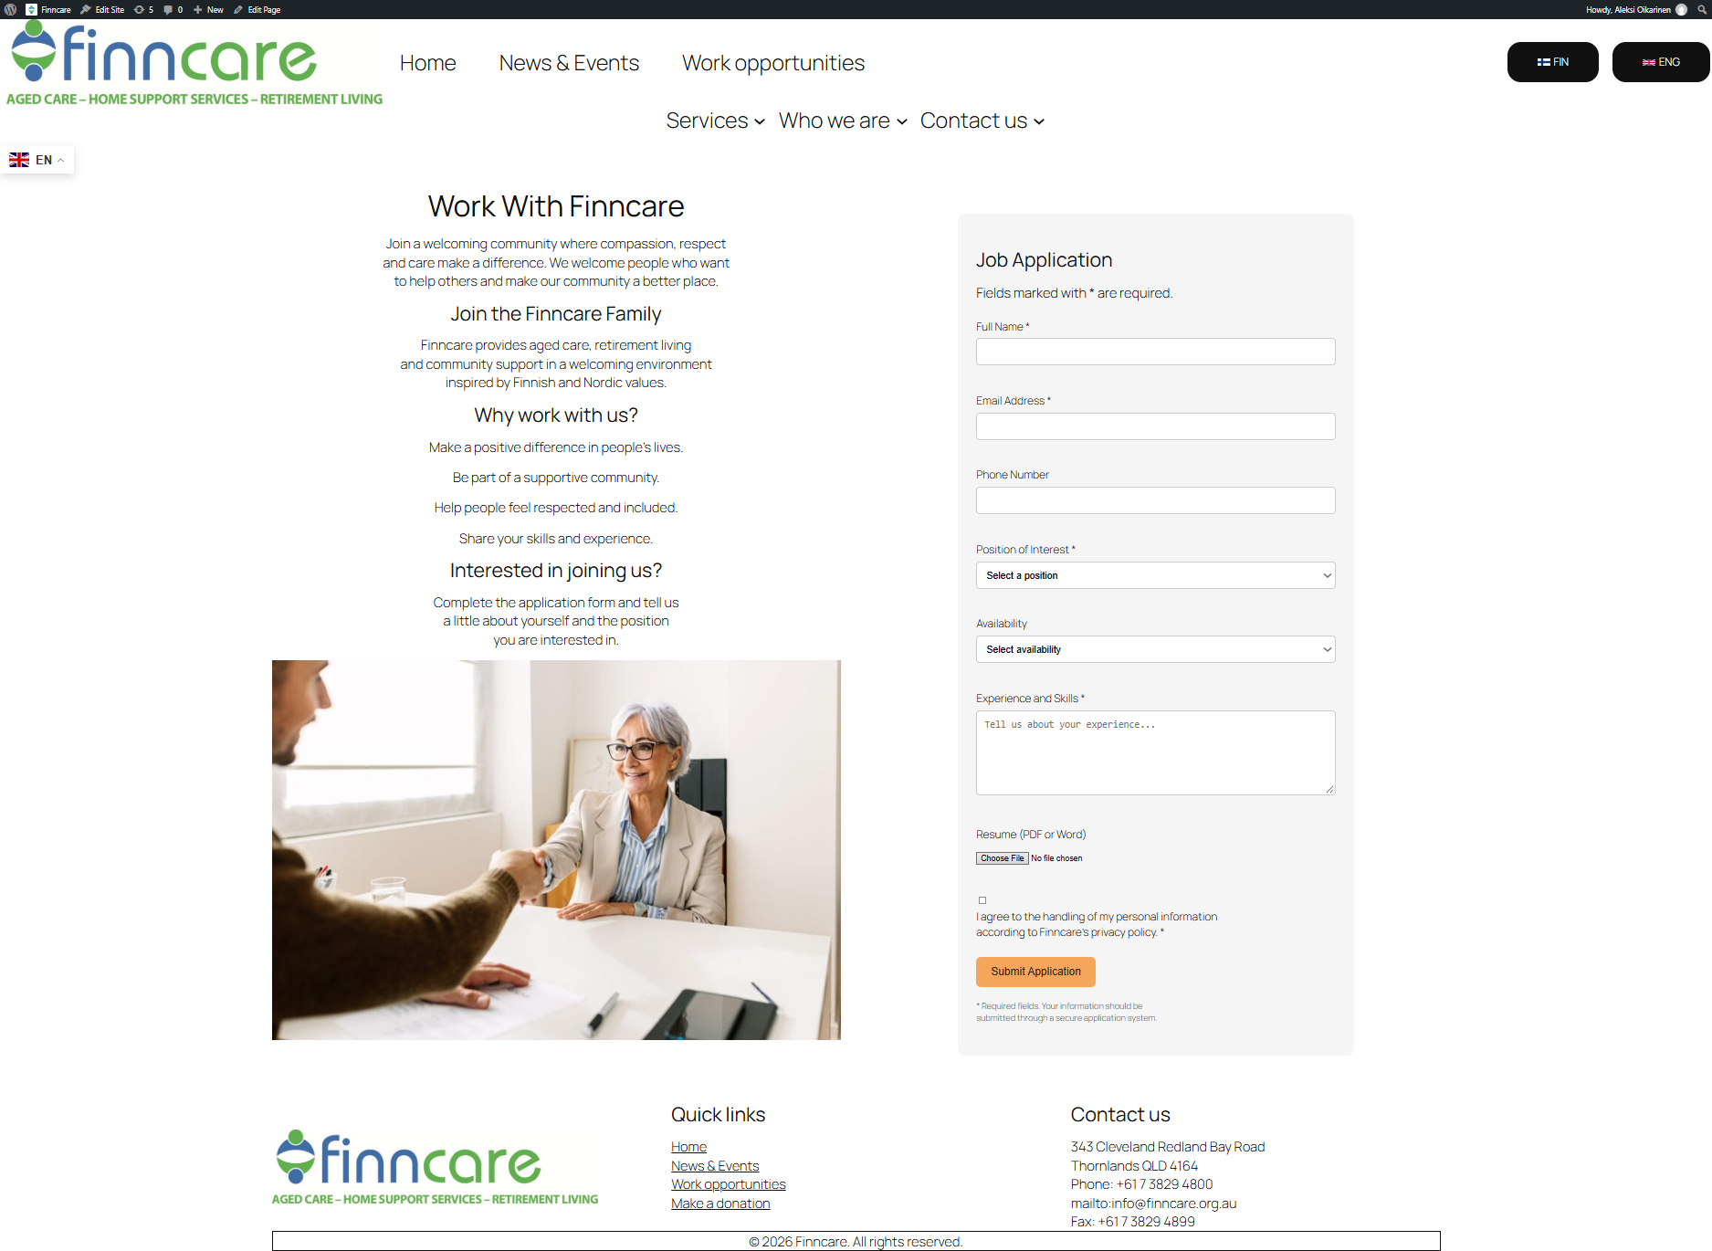
Job application site
Easy to use
Low maintenance

Slide 5
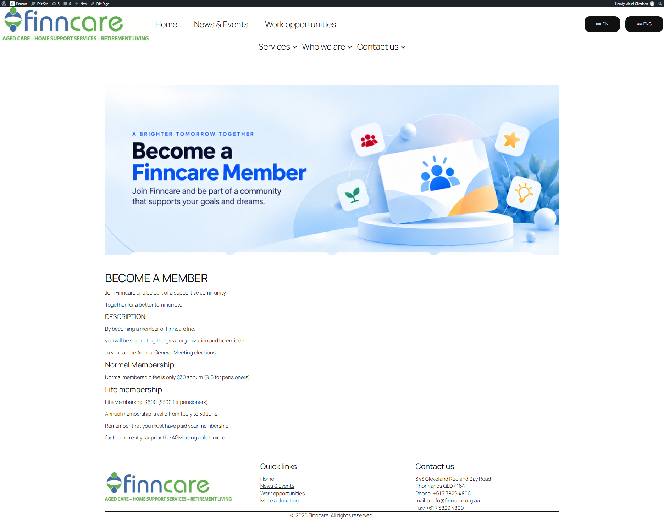
Become a member
Informative
Clear text
Options

Slide 6
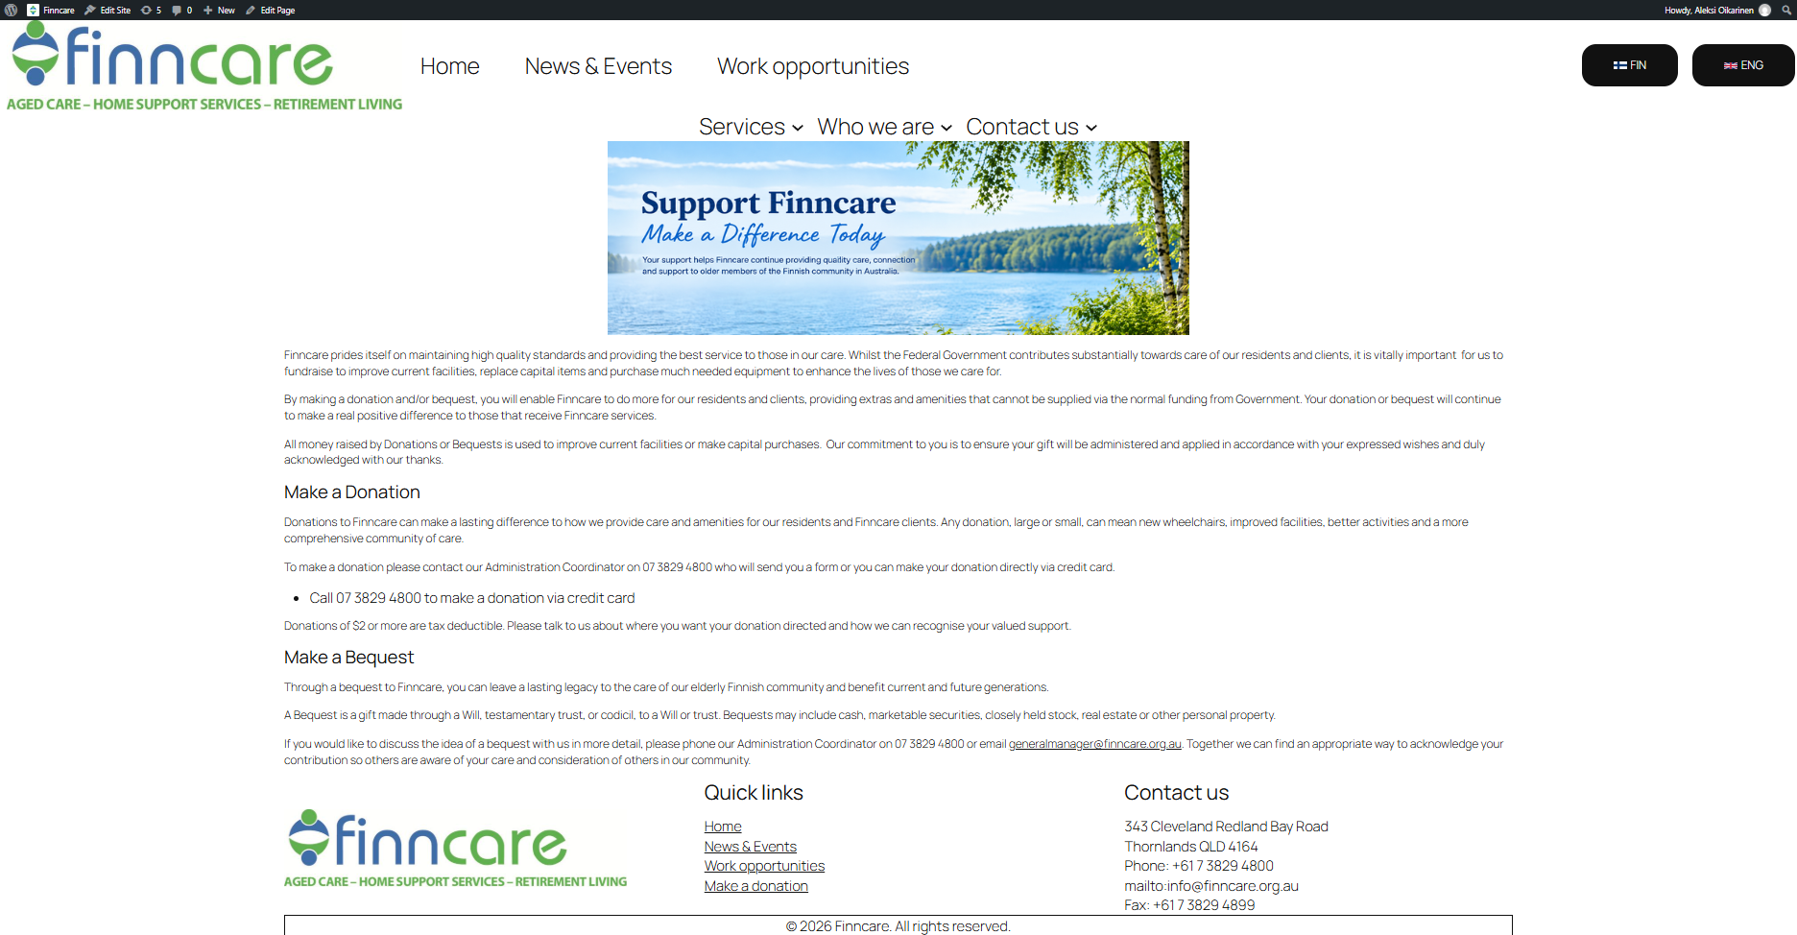
Donation page
Informative
To the point
More text to inform

Slide 7
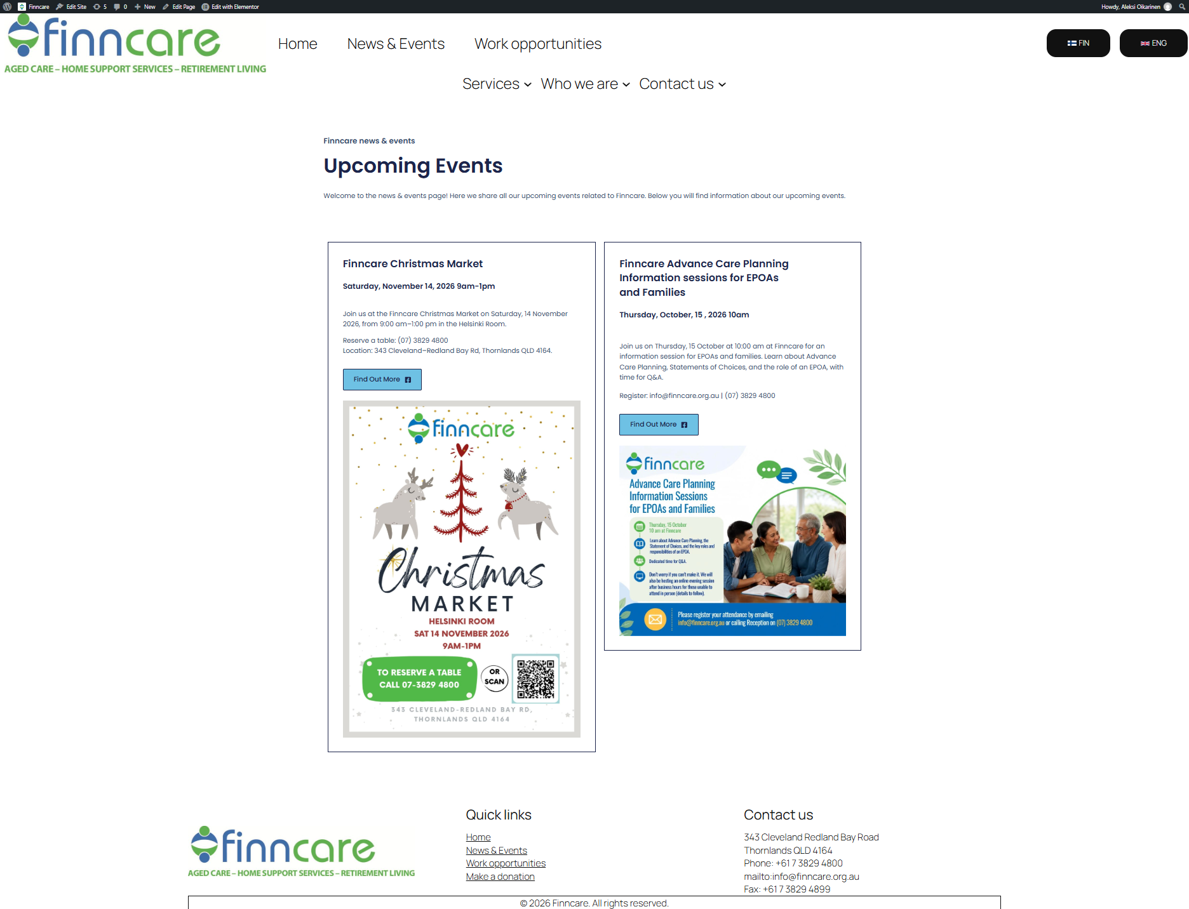
News & Events
Clear view
Easy layout
Easy to add content

Slide 8


Language selector
Language selection top right of every page
Easy to spot

Slide 9
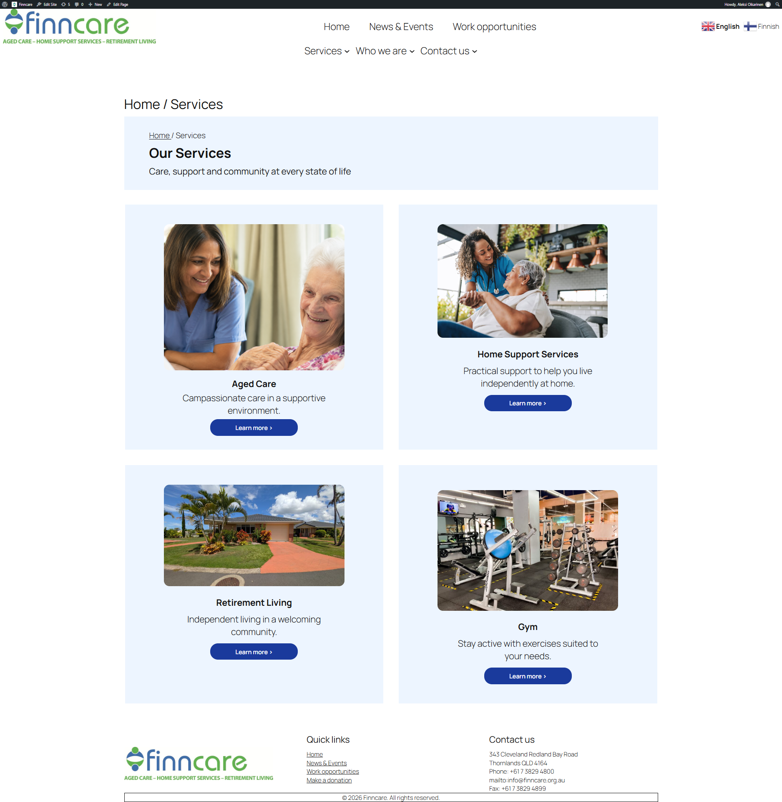
Our Services
Quick access page
Option displayed visually
Easy to use
Clear call-to-action buttons

Slide 10
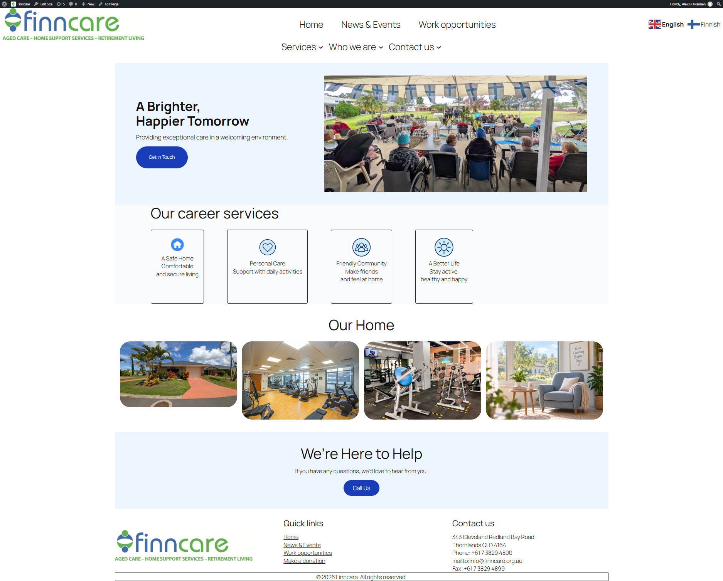
Aged care
Presentation of aged care informaton with clear heading and description
Highlighted the benefits of aged care services
Added images and visual elements
Straight to the point
Added clear call-to-action buttons.

Slide 11
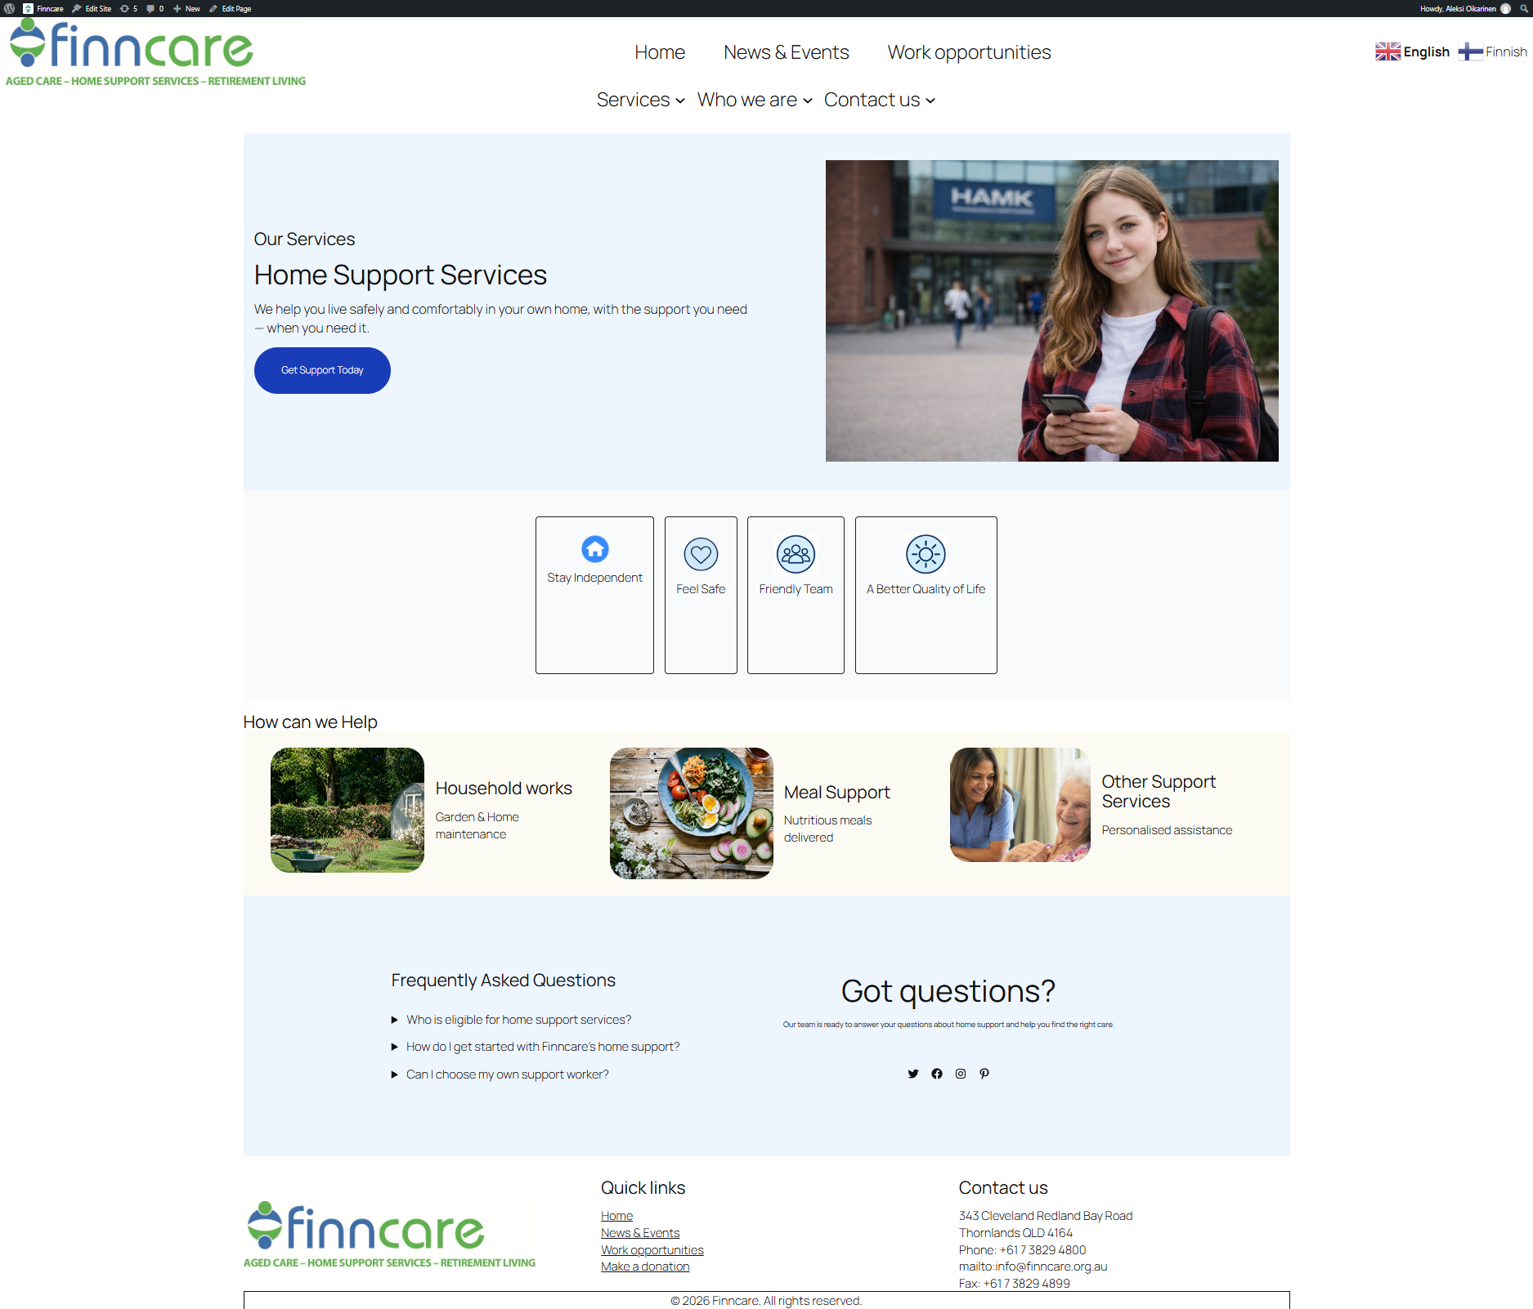
Home support services
Limited text
Highlighted the key benefits of home support
Added home support services into separate sections such as household assistance, meal support and other support services.
Added services related images and icons
Added frequently asked question section.

Slide 12
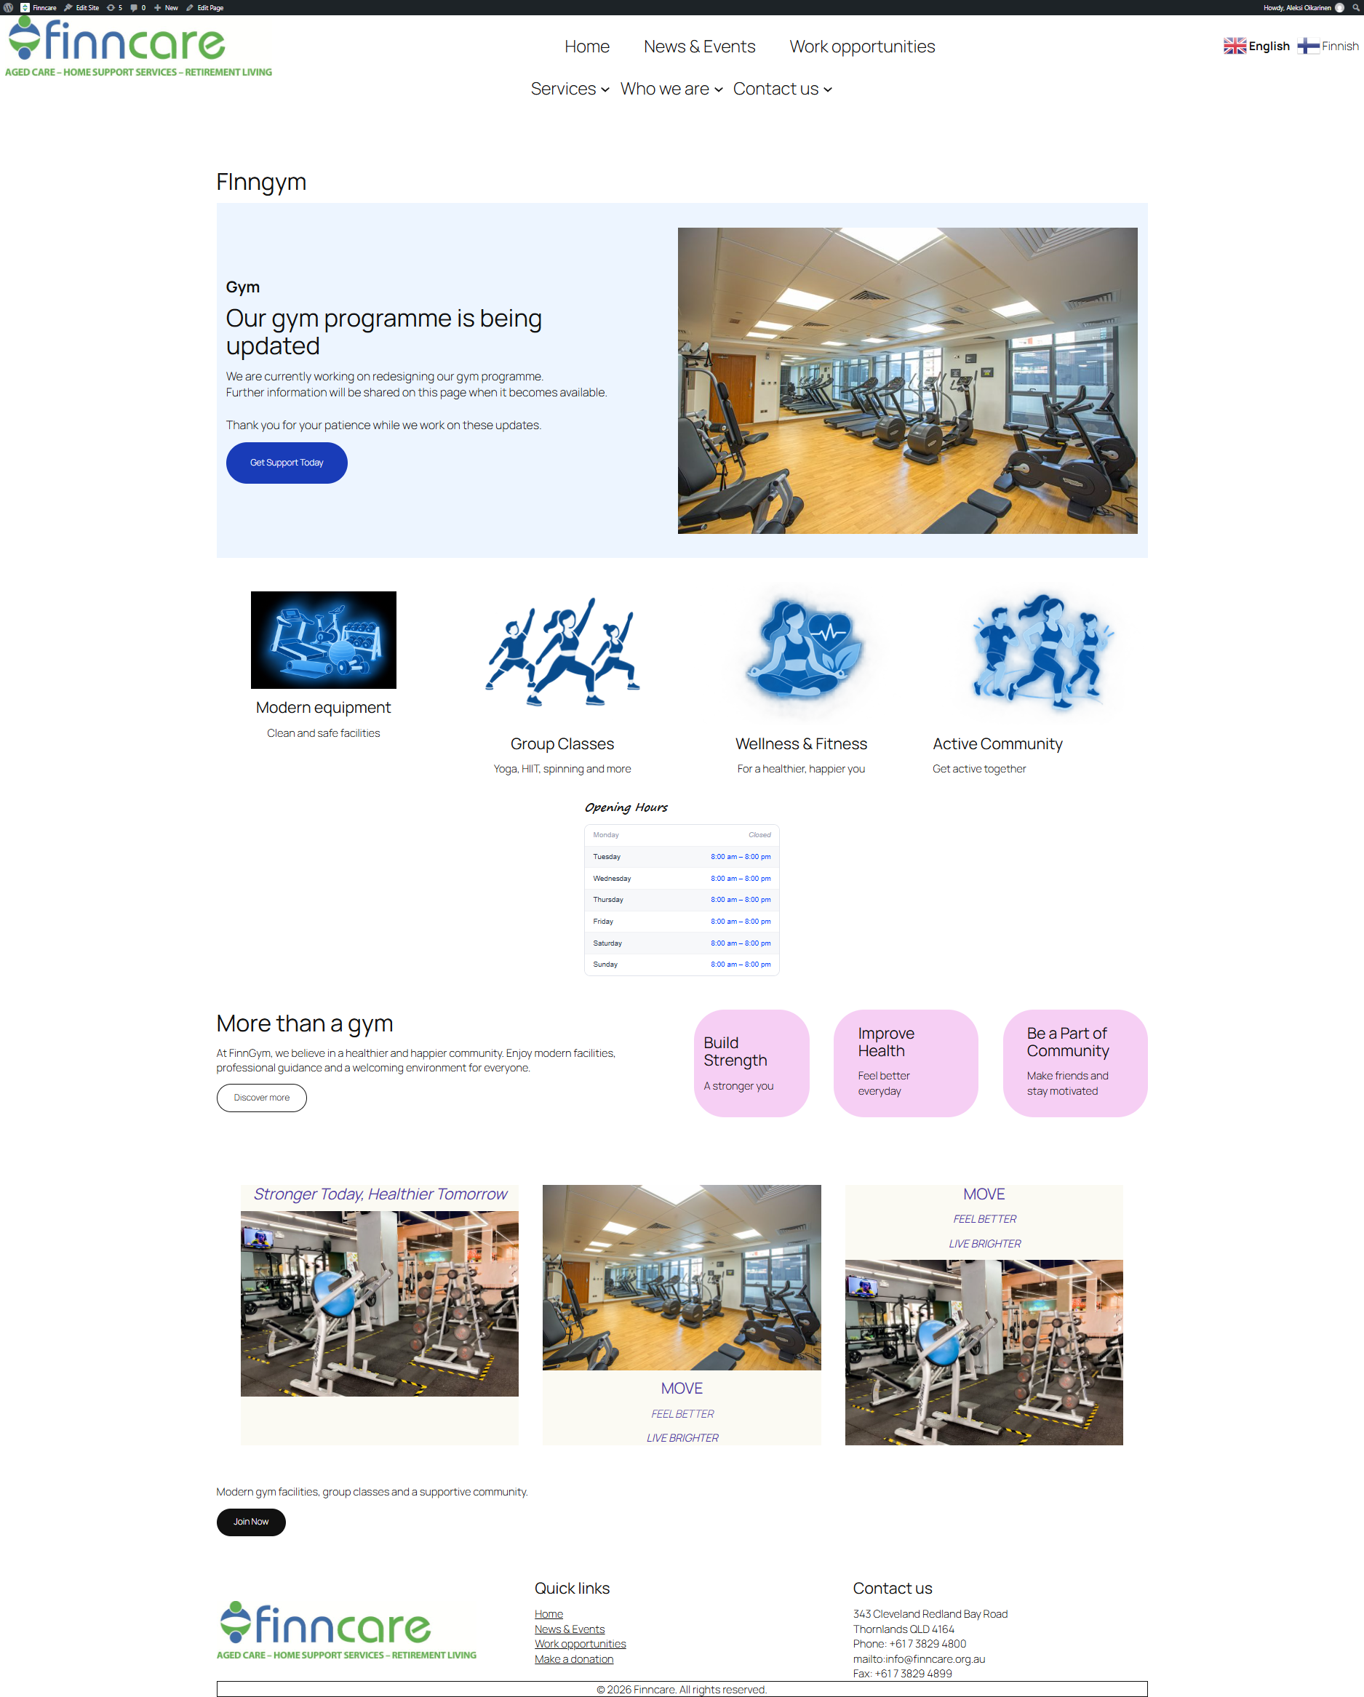
Gym site
Notifying about update
Visually pleasing
Visible timetables

Slide 13
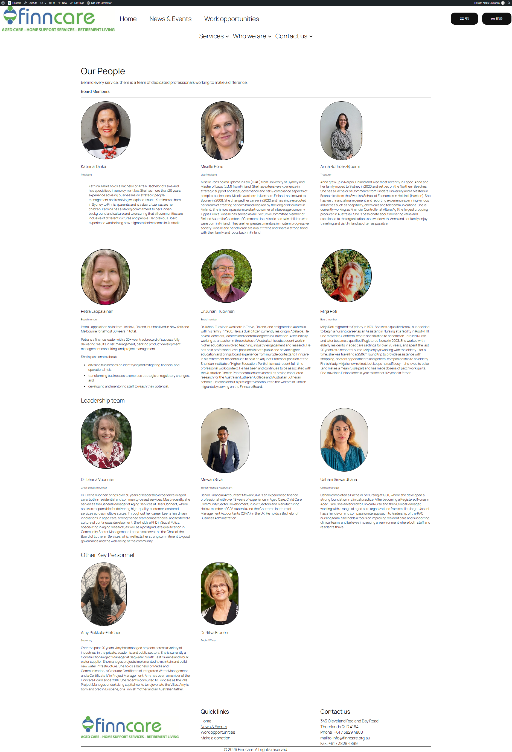
Our people
Easy to update
Clear text
No hastle

Slide 14
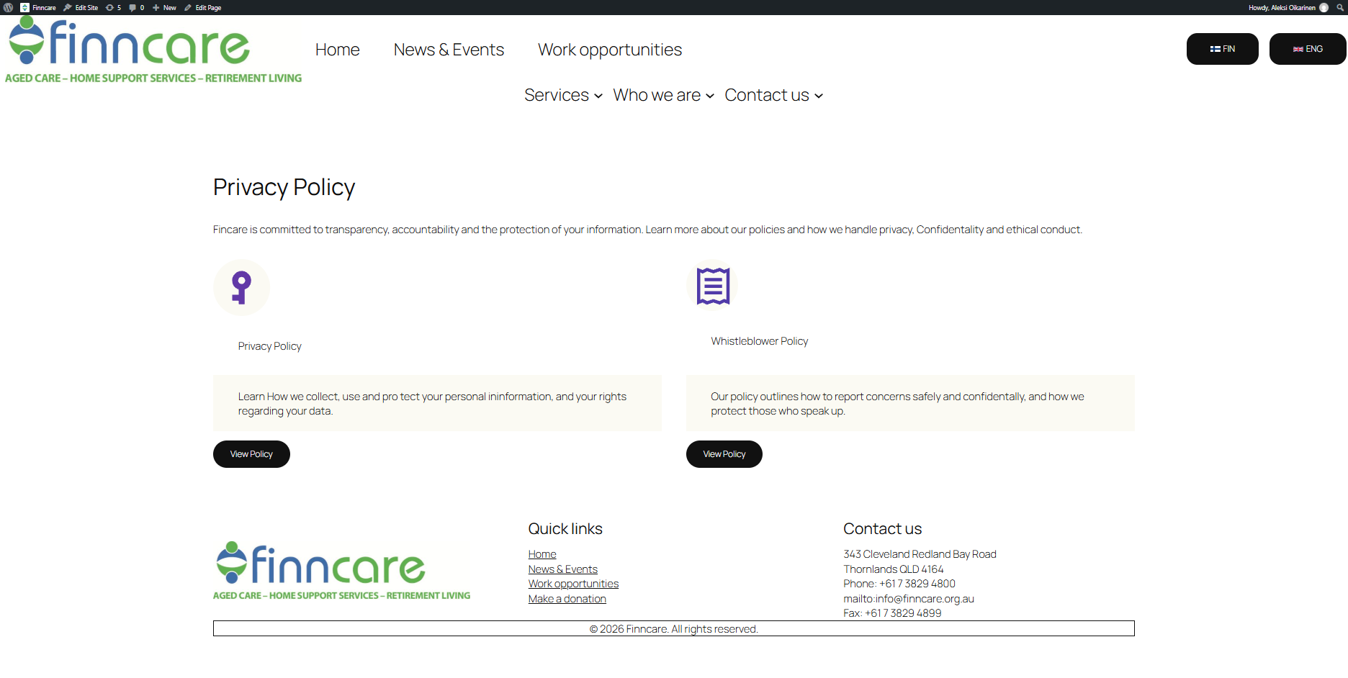
Policies
Easy access
To the point

Slide 15
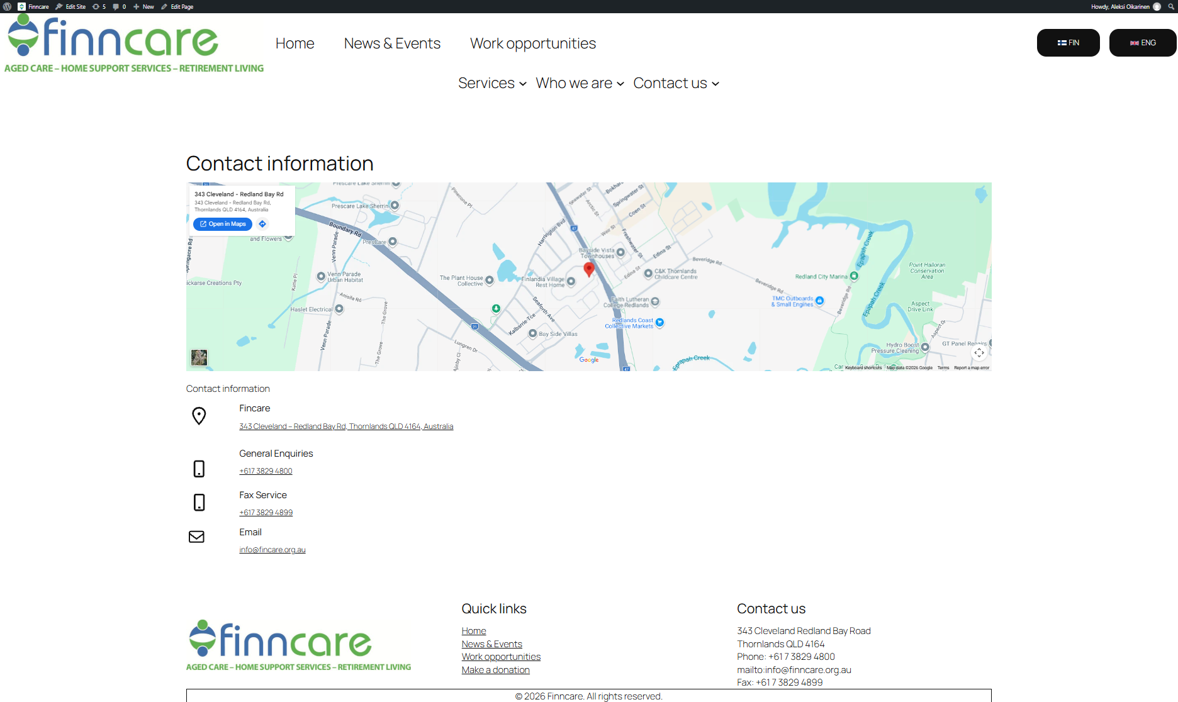
Contact information
Visual location
Easy to read
To the point

Slide 16
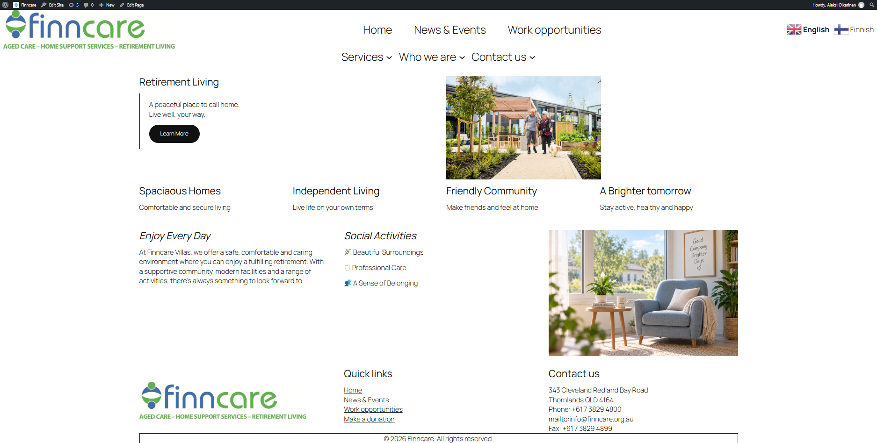
Retirement living
Great contrast
Limited text
Simple is better
Highlighted main benefits, such as spacious homes, a friendly community and social activities.

Slide 17
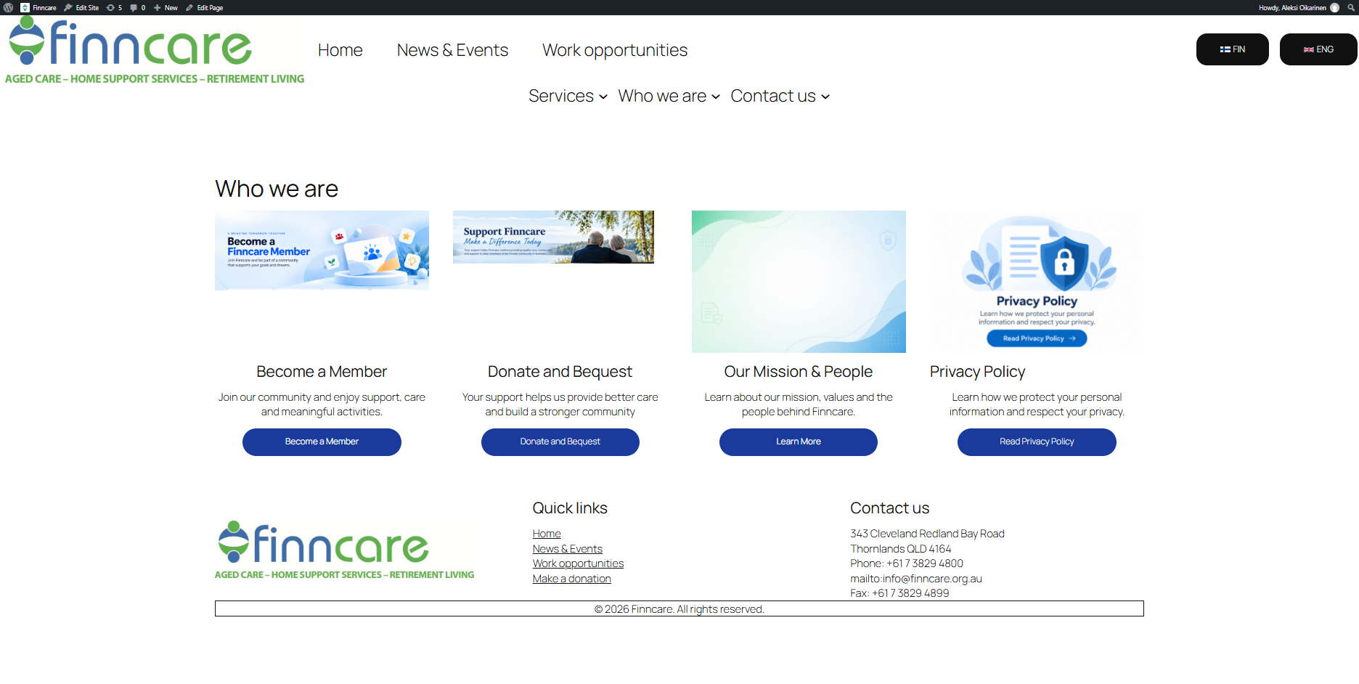
Who we are
Quick access
Easy to use
No hastle
Helps visitors learn more about finncare.
Visitors can find relevant information by using button.

Slide 18

Thank you for listening
We hope you enjoyed our presentation!

